Slide 1

Financial Risk Prediction
Machine Learning Model

Slide 2


Agenda
Background | 3
Business Goals | 4
Dataset Overview | 5
Implementation Overview | 6
Challenges and solution | 7
Further Implementation | 8
Demonstration | 9

Slide 3

Background
Why financial risk evaluation?
Many people default on loans
Banks need to predict the risk of each loan applicant
Machine learning can help by analyzing data about applicants to predict their financial risk

Slide 4







Goal 01
Reduce loan defaults by accurately predicting financial risk
Business Goals
Goal 02
Automated risk prediction for better decisions
Help banks make better decisions through data-driven risk assessment
Goal 03
Automate and simplify risk prediction for faster, fairer results

Slide 5

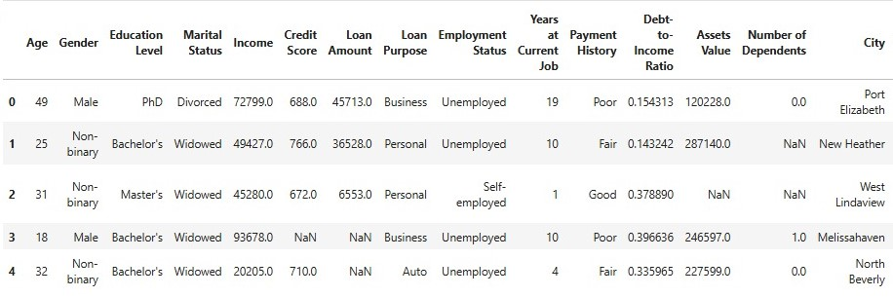
Dataset Overview
Dataset source: Kaggle
Dataset includes features such as age, income, credit score, loan amount, and more
Predictive target:
Low, High
Both numbers(e.g. income) and categories(e.g. Loan purpose )

Slide 6




Software Tools Used
Programming Languages: Python
Tools/IDEs: Jupyter Notebook, Visual Studio Code
Web Development: Streamlit, HTML, CSS

Slide 7

Implementation Overview
Data Preprocessing: Handled missing values, encoded categories, and scaled features
Class Balancing: Used SMOTE to fix imbalances.
Briefly elaborate on implementation
Model Selection: Logistic Regression
Random Forest
Gradient Boosting
K-Nearest Neighbors
Support Vector Machine(SVM)
Model Tuning: Hyperparameter tuning, Cross-validation

Slide 8
Challenges and Solution
Data quality issues
Data cleaning and preprocessing technique used
Class imbalance
Used SMOTE to create balanced data
Different data types
Standardized the data for consistency
Overfitting
Hyperparameter tuning and cross-validation

Slide 9
Integration
Further Implementation
Embed the model into a financial institution’s loan approval process
Broader use cases
Expand the model’s application to insurance risk assessments
Deployment
Deploy model using a web based application

Slide 10



Demonstration
Web application
INDEX.HTML

Slide 11
Bandara K M W G L A
IT22089304
Jayasinghe J M H C
IT22597342
Our Team
Abeysinghe E A
IT22166692
Wicramasinghe D A T N
IT22113504
Mesandu W M S
IT22108890

